Slide 1

B18 Lesson 2
Bishop Stopford School
faith | justice | responsibility | truth | compassion
ONLINE LEARNING
Learning Objectives
Retrieval
Acquire
Action
Review
Dig Deeper

Slide 2
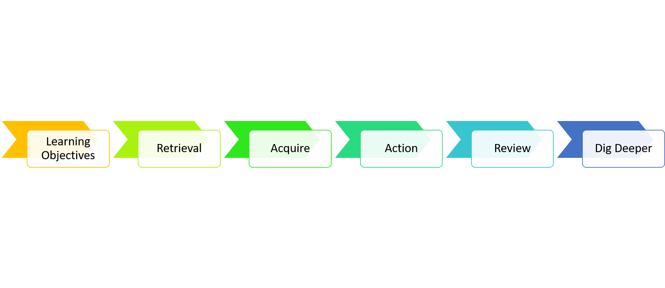
Land Use
Give examples of how human reduce the land available for animals and plants
Explain the issues associated with peat bog and forest habitat destruction
Evaluate pros and cons of deforestation

Slide 3
Starter
State one way humans pollute
1) Land
2) Air
3) Water
Check back to your table from last lesson if you can’t remember!

Slide 4


Watch Video 1
You can watch this video as many times as you want to

Slide 5
Watch Video 2

Slide 6
Key Notes
The larger the human population gets, the more land we require. More houses must be built, more resources found, more food must be grown and more waste is produced. This often means less space and fewer resources for other animals and plants.
The destruction of peat bogs is one example of how we have reduced the area of a habitat and thus the variety of different plant, animal and microorganism species that live there.
Humans have been cutting down trees for thousands of years. However, this clearing of forests has accelerated in recent decades and is now being carried out on a large scale. This is known as deforestation.

Slide 7
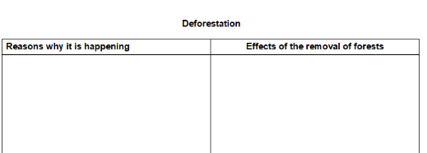
Task
Read the articles on deforestation on the firefly page and then complete the deforestation table
https://bishopstopford.fireflycloud.net/science-2/school-closure-tasks/year-10-1/biology/triple/b18-biodiveristy-and-ecosystems

Slide 8

Review
RAG (red, amber, green) the learning objectives you wrote down at the start to show how confident you are with them

Slide 9
Dig deeper (optional)
Write a speech arguing either for or against the clearance of forests for human use

